Slide 1
Cloud Prototyping SS19
Approaches on Privacy

Slide 2
Goals
Efficiency gains through off-chaining
Privacy of meter values
Preserve properties of (Ethereum) blockchain by off-chaining via ZoKrates

Slide 3
Assumptions
ZoKrates trusted setup executed
Appropriate set of constraints for witness computation defined
ZoKrates Verification contract deployed
dUtility contract has access to verification key
Households = Authority nodes
Ethereum addresses mapped to identities

Slide 4
Approach 1 (Dong)
Introduce a netting entity (Ned)
Not an authority
Has access to the proving key
Exposes API to send sensor data to

Slide 5
Approach 1 - Steps
Households
Create one time usage key pair and save to local DB
Send aggregated sensor data to Ned and sign data with one time usage key pair
Ned
Execute netting algorithm with pseudonymously signed sensor data (compute-witness)
Use witness (2.a) and proving key to generate proof
Send netting result and proof to dUtility contract
dUtility
Verify proof from Ned (call verifyText of Verification contract with verification key)
Figure out reasonable properties/ invariants of the desired settlement algorithm
If verification successful → Emit DeedCreated event with pseudonymous addresses and amounts
Households listen for DeedCreated events and filter for owned pseudonymous addresses

Slide 6
Approach 1 - tradeoffs
Ned needs too much trust
could possibly save all addresses
More or less every component needs adjustments
Hashed Data to the Blockchain
Aggregated value public?

Slide 7
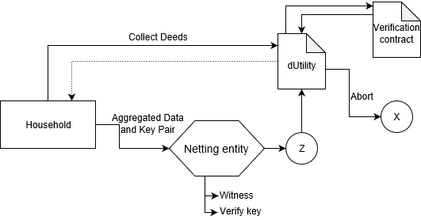
Approach 1

Slide 8
Approach 2 (Myron)
Do not expose smart meter values of households
still track correct meter values comprehensively
Do not expose transferred and received energy values of household by netting
still manage to track correct energy transfer
do not expose trading history such as (deeds: from, to)

Slide 9
Approach 2 - Step 1
Households
ZoKrates HLC performs naive hashing of smart meter values
Generate proving key, verification key and proof
Share verification key with dUtility contract
Send proof and hash to dUtility contract
dUtility contract
Stores verification key and household address (hash and proof)
Verifies meter values using the Validator contract with hash, proof and verification key

Slide 10
Approach 2 - Step 2 (Prepare Netting)
Households
ZoKrates HLC compute need/available energy amount
Constraint: I know two values that are equal to p-c and those are hashed equal to the hash value stored on the chain (known/given hash function)
p-c = difference of produced and consumed energy
Send proof and meter value difference to dUtility contract (hash is known)
dUtility contract
fires prepareNetting event ( → Households)
Compute overall needed/ available amount of renewable energy
Verify difference of produced and consumed energy using Verification contract
Fire performNetting event after verification ( → Households)

Slide 11
Approach 2 - Step 2 (Perform Netting)
Households
ZoKrates HLC compute proportion of overall needed/ available energy, calculate transfer/ receive energy value by netting
Constraint: I know two values that are equal to the proportion (transfer energy value or receive energy value) and those are hashed equal to the hash value stored on the chain (known hash function)
dUtility contract
Verify transfer/ receive energy values using Verification contract
Fire endNetting event ( → Households; starts Step 1)

Slide 12
Approach 2 - tradeoffs
No deeds
Instance that manages the energy transfer needed
Higher number of transactions
n Households → at least n² transactions per smart meter update (Step 1)
n Households → at least n² transactions per netting execution (Step 2)
Extra deployment verify contract
Have to wait for HH → what if HH is offline?

Slide 13
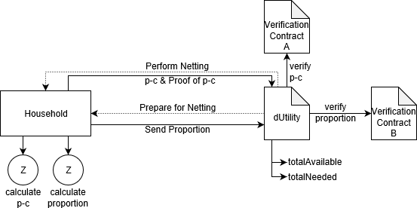
Approach 2

